Slide 1

Restaurant Review Sentiment
Analysis

Slide 2
Overview
Post COVID, online food ordering business grew rapidly which increased the value of reviews by customers for a restaurant. The ability to analyze data from customers has great value to a business that can leverage the data to improve.
The project converges on using open source data to analyze the sentiments of the customers for the restaurants. On the basis of customer reviews the project indulge model building for improvement of the restaurant business. The project uses text data of different reviews and apply various suitable models which helps in the analysis of sentiments on the basis of customer reviews. The project also comprise of recommending the restaurants to new customers. The project consist of in-depth analysis and visualization on the data for achieving improvement in
business.

Slide 3
Technologies and Implementation
Extraction and Connectivity
of Data
Processing Data and
Loading Data
ML and Data Visualization
Open source restaurant data
Imported through GitHub
The connection was established using mongo-spark-connector_2.12
Data was processed and transformed using Spark
Data stored in MongoDB
ML algorithms were applied on appropriate datasets in python
Data visualization was performed in Power BI using mongodb-connector-odbc-1.0.0-win-64-bit

Slide 4
NLP algorithm(NLTK, VADER, TextBlob)
The project uses NLTK to clean the text containing punctuations, stopwords like articles, pronouns, etc. It also used for stemming / lemmatization of words in order to get the root of the word.
The project uses VADER (Valence Aware Dictionary for Sentiment Reasoning) to classify sentiments into the categories as positive, negative and neutral. Use of VADER helped not only in the classification of above categories but also helped in analyzing the customer sentiments accurately.
The project uses TextBlob to analyze the customer sentiments which helps in calculation of a sentence’s polarity, to label the reviews as positive or negative.

Slide 5
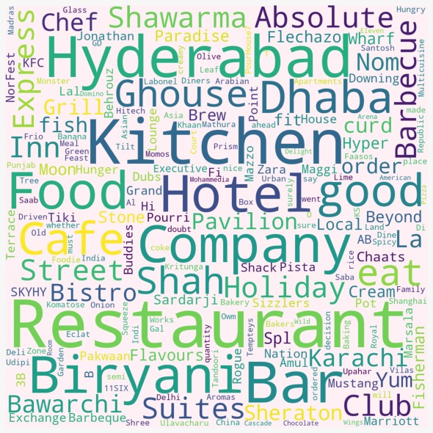
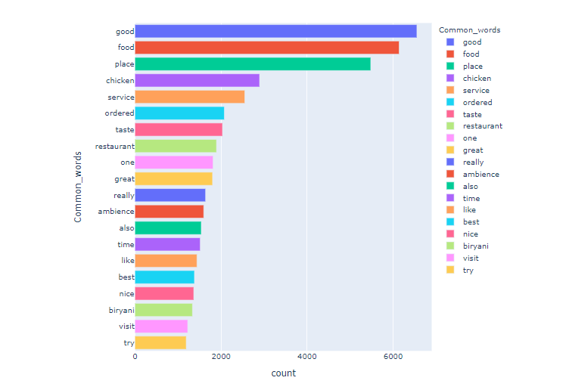
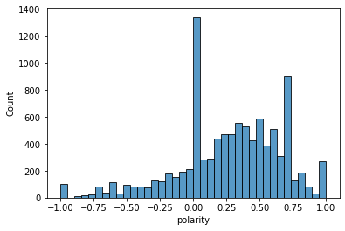
Exploratory Data Analysis and Inferences
Word cloud with restaurant names
Most common words used in reviews
Count of polarity

Slide 6
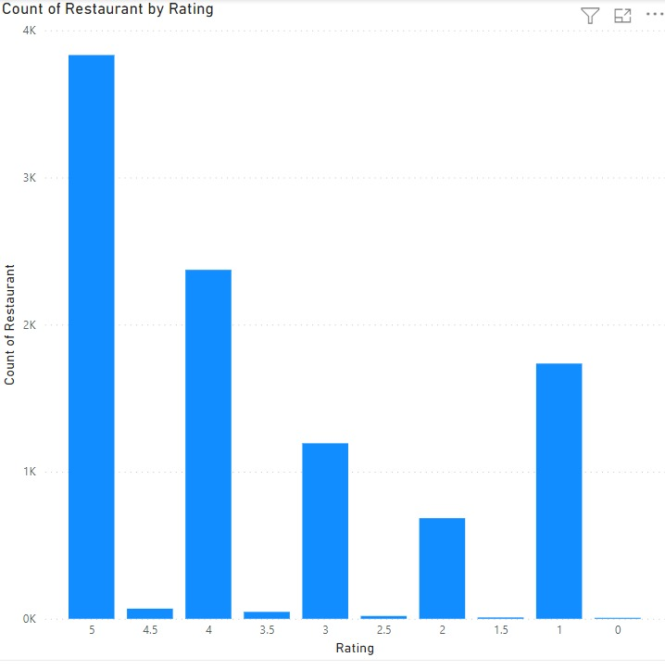
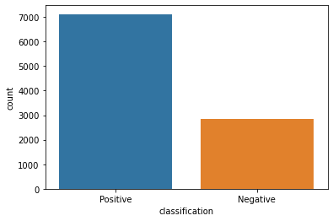
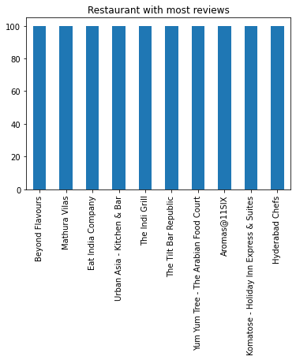
Ratings distribution for restaurants
Reviews distribution for restaurants
Restaurants with most reviews

Slide 7
Machine Learning Algorithms
Support Vector Machine (SVM), K-Nearest Neighbour (KNN), Random Forest, Logistic Regression.
Algorithms Accuracy
Support Vector Machine (SVM) 0.754432
K-Nearest Neighbour (KNN) 0.699899
Random Forest 0.698895
Logistic Regression 0.596930

Slide 8
Models and Findings
Model 1: Sentiment analysis on the basis of reviews
Model 2: Recommendation System for restaurants
Findings:
The NLP algorithms (TextBlob, VADER) classify the sentiments in positive, neutral and negative categories respectively.
The calculation of polarity on the basis of customer reviews for restaurant business splits into 70% positive reviews and 30% negative reviews.
Findings:
The recommendation system recommends the restaurants on the basis of user input.
The recommendation system helps users to pick the restaurant based on the customer reviews and ratings.

Slide 9
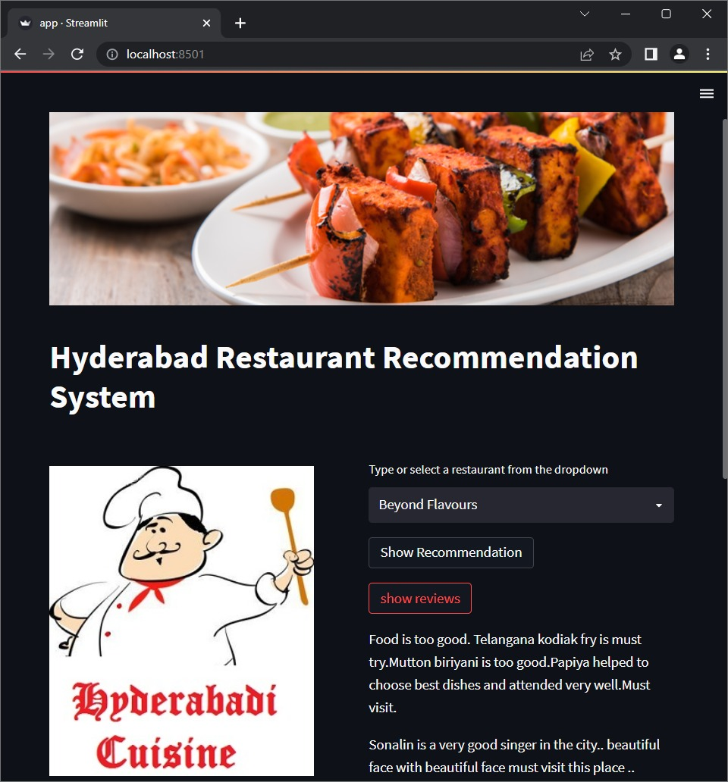
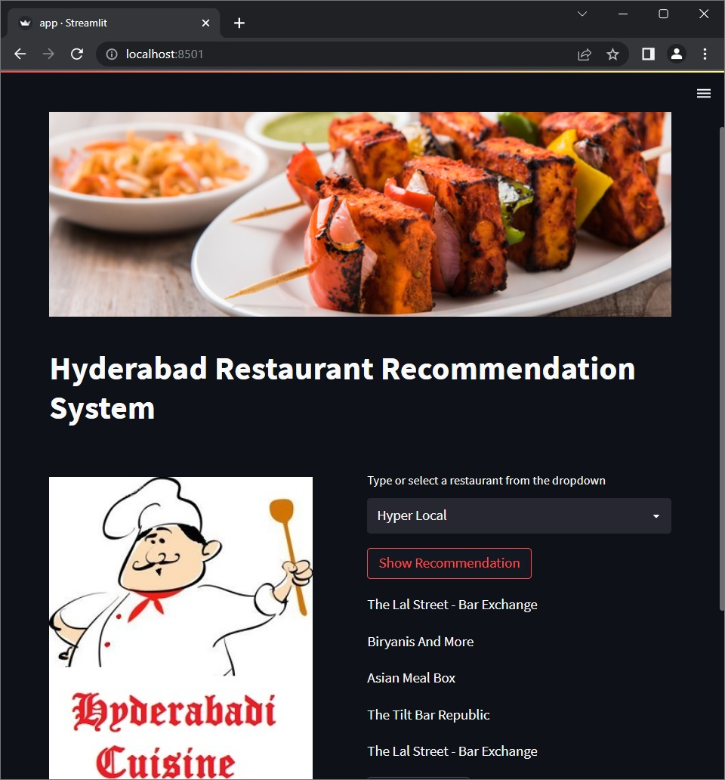
Restaurant Recommendation System
User input: Restaurant
Output: Top 5 reviews and restaurants for chosen restaurant

Slide 10
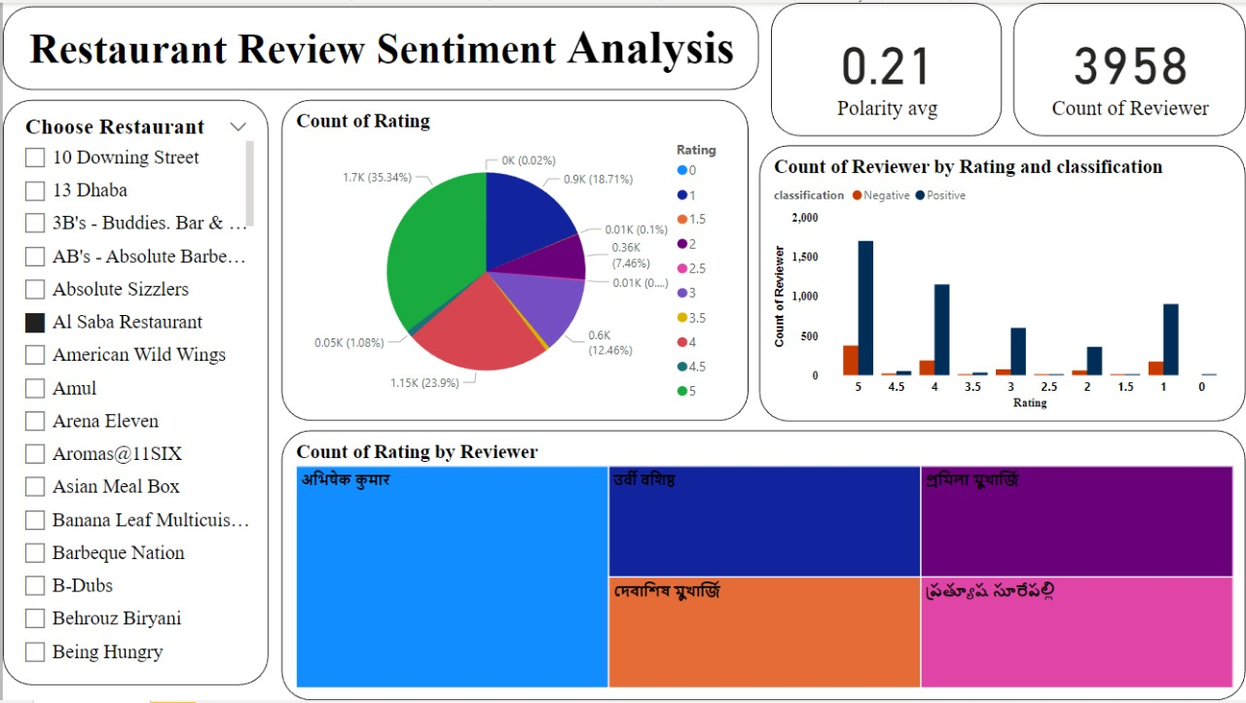
Power BI Dashboard

Slide 11
Future Scope
This project has a lot of strength, the analysis carried out is from business perspective and can extend the functionality and overview of the project by creating the application from user perspective.
In order to increase the performance and speed of analysis, the data can be dumped on cloud so that there is no requirement to load data every time the analysis is carried out.
Future scope includes building a module by which all these trends and insights are communicated to business in real time so that businesses can get faster feedback.
This project also anticipates to extend the analysis for restaurants pan-India.

Slide 12
Conclusion
The project fulfills the objective of performing sentiment analysis on the basis of reviews of restaurant business and produce vital insights and details to the business owners. The system designed also recommends the users to choose restaurant based on reviews and ratings. The project credits that the system will definitely add more value and contribute to grow the businesses of restaurant owners.

